Slide 1

Indian Institute of Information Technology, Nagpur
Computer Science Engineering Department
IMAGE DENOISING USING BLENDER & DEEP LEARNING
Under Guidance of:
Dr. Nishat Ansari
Presented By:
Ved Vartak (BT21CSE177)
Abhishek Kumar (BT21CSE188)
Shreyash Suradkar (BT21CSE105)
Nitin Kumar (BT21CSE112)

Slide 2


INTEL OPEN IMAGE DENOISE
Overview: Open Image Denoise is an Intel-developed library for high-performance, AI-powered denoising of rendered images, targeting ray tracing applications.
Model: It utilizes deep learning models optimized for Intel architectures, particularly leveraging the capabilities of CPUs for seamless integration.
Performance: The library delivers high-quality denoising, preserving fine details, textures, and sharpness in rendered images across a variety of scenes.
Results: Benchmarks show excellent performance and quality, making it a preferred choice for film production, architectural visualization, and gaming.
Conclusion: Open Image Denoise is a powerful, open-source tool that enhances rendered image quality, supporting professional and creative workflows.

Slide 3

GENAI IN BLENDER: TRANSFORMING IMAGE PRODUCTION
Overview: The paper discusses enhancing Blender's functionality using Generative AI technology to empower artists.
Model Name: Utilizes Generative Adversarial Networks (GANs) like StyleGANs and Stable Diffusion.
Methodology: Developed a user-friendly add-on with a prompt-based architecture for seamless integration of AI-generated content.
Result: High-quality, realistic images generated with vivid details and consistency using AI models.
Conclusion: The integration of Generative AI in Blender revolutionizes artistic expression, enabling artists to effortlessly incorporate AI-generated content into their workflows

Slide 4
TOWARD DNN OF LUTS: LEARNING EFFICIENT IMAGE RESTORATION WITH MULTIPLE LOOK-UP TABLES
Overview: The problem involves hiding information in a 2000 x 2000 color image using LSB steganography.
Model Name: LSB (Least Significant Bit) Steganography.
Calculation: Each pixel can hide 3 bits of information (one bit per color component: Red, Green, Blue).
Result: The total number of bytes that can be hidden is 1,500,000 bytes.
Conclusion: LSB steganography allows significant data to be hidden in an image by modifying the least significant bits of each color component.

Slide 5

REAL-TIME NOISE SUPPRESSION USING DEEP LEARNING
Overview: NVIDIA's Real-Time Noise Suppression (RTNS) leverages AI to enhance voice quality by reducing background noise in real-time, targeting applications like video conferencing and live streaming.
Model: It uses a deep learning-based framework built on the U-Net architecture, optimized for NVIDIA GPUs to deliver low-latency performance.
Performance: The model achieves superior noise suppression while maintaining natural voice quality, outperforming traditional DSP-based techniques.
Results: Demonstrated significant improvements in audio clarity across diverse noise scenarios, making it highly effective for real-world applications.
Conclusion: NVIDIA’s RTNS offers a robust, scalable solution for real-time communication, setting a new standard for AI-driven audio enhancement.

Slide 6
METHODOLOGY
Dataset Preparation
File: dataset2.zip
Processing: Images resized to 64x64x3.
DataLoader for Data Loading and RanCropDataLoader for random patches in a data
Model Definition
Input Shape: (64, 64, 3).
Architecture: Includes convolutional layers, likely resembling a Modififed U-Net encoder-decoder for denoising.
Training
Optimizer: Adam.
Loss Function:Combined Loss (MSE and SSIM)
Batch Size: Configured for efficient training.
Epochs: Trained for a defined number of iterations(30).

Slide 7
METHODOLOGY
Evaluation
Dataset: Test images for model validation.
Metrics: Loss reduction and visual comparisons of noisy vs. denoised images.
Visualization
Tools: matplotlib.
Results: Displays noisy, clean, and denoised images along with potential loss/accuracy plots.

Slide 8

NOISE IN BLENDER
Caustics are a well-known source of noise, causing Fireflies. They happen because the renderer has difficulty finding specular highlights viewed through a soft glossy or diffuse reflection. There is a No Caustics option to disable glossy behind a diffuse reflection entirely. Many renderers will typically disable caustics by default.

Slide 9
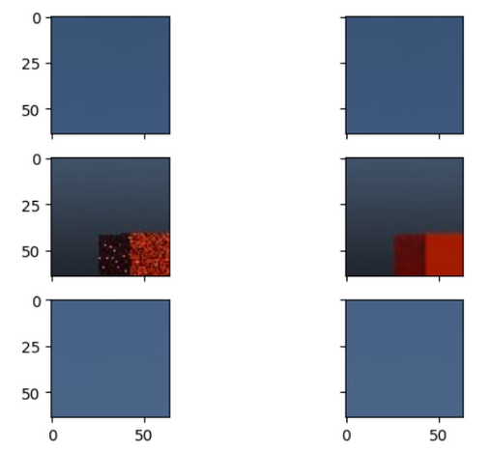
DATASET CREATION
To create dataset for our denoiser we used Blender to render 3D Models at different sampling rate (Ex: For Nosiy Data Sample 1spp and for Denoised Dataset 1024spp)
Blender is a free and open-source 3D creation suite that supports modeling, sculpting, animation, rendering, video editing, and VFX.
We created scene with a plane and placed cubes on it at random position and random orientation with random material using Geometry Shaders.
To generate Renders we used Blenders scripting API to place camera at random position for every image sample.

Slide 10
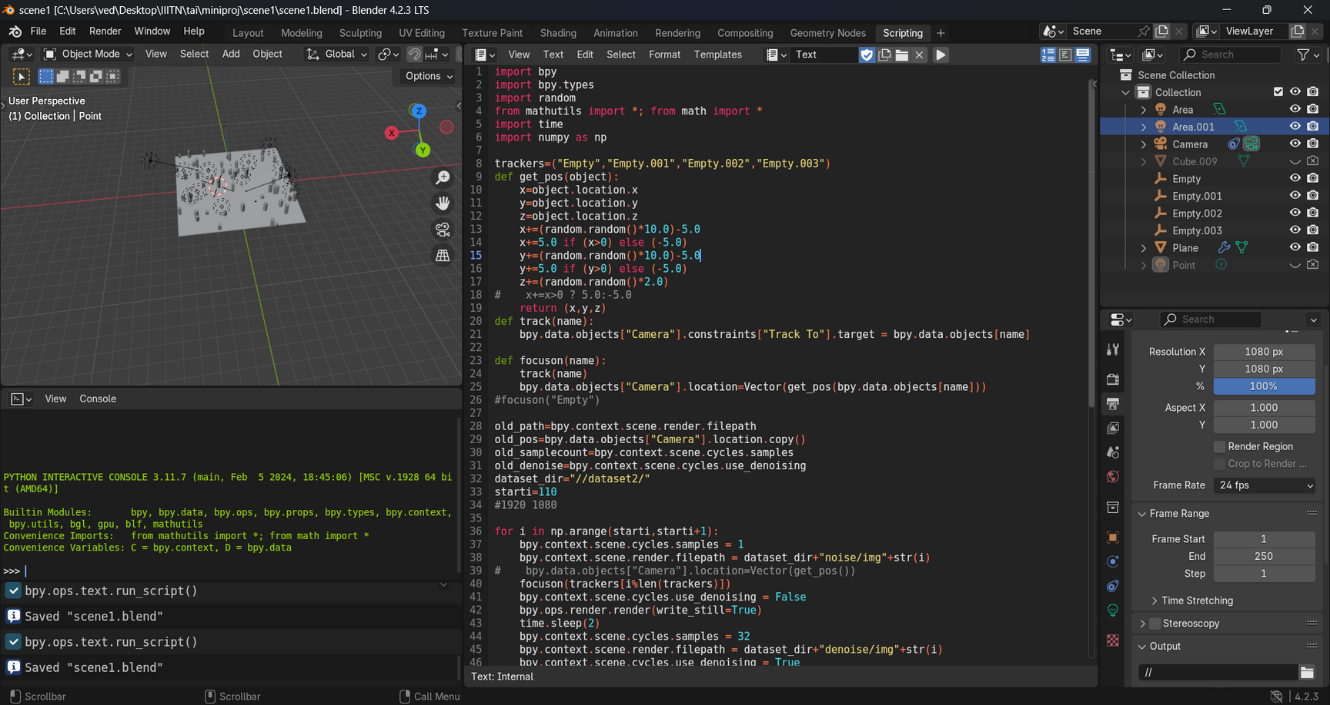
DATASET CREATION

Slide 11
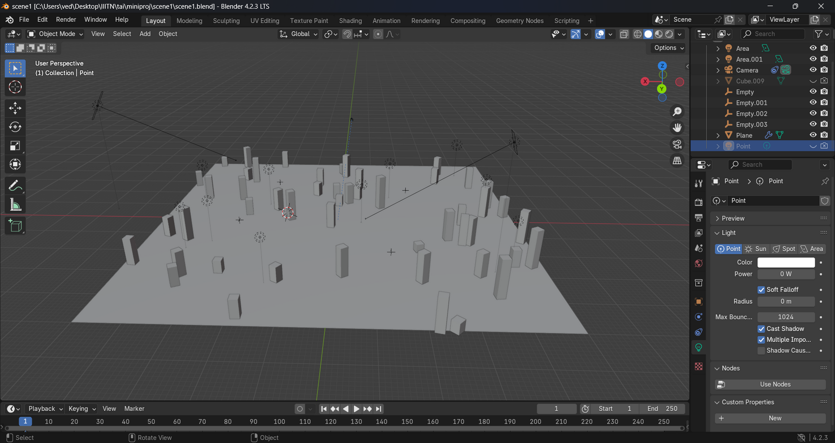
DATASET CREATION

Slide 12
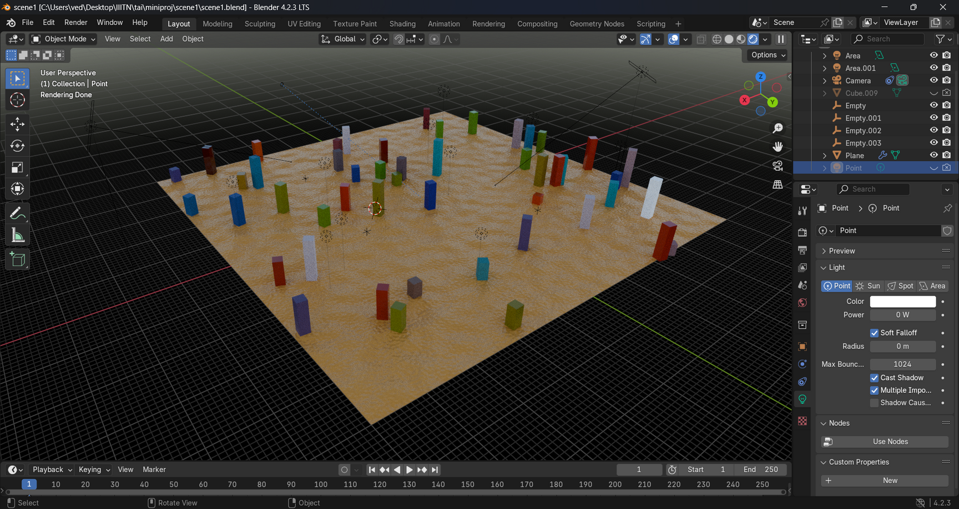
DATASET CREATION

Slide 13
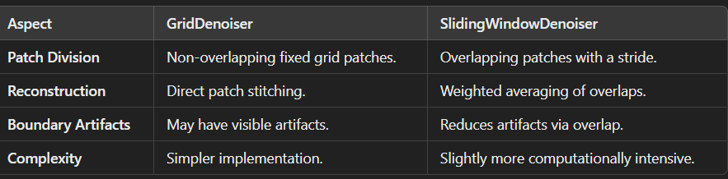
ABOUT MODEL
Base Model :- Modified UNet Architecture
The architecture is a Modified UNet with residual blocks and skip connections, designed for image-to-image tasks. It consists of an encoder-decoder structure with symmetric layers, utilizing transposed convolutions for upsampling and feature concatenation at each decoding stage. The final output uses a sigmoid activation for generating the denoised image.

Slide 14
NOVELTY
Created won Dataset using Blender Tool
Used unique architecture named ModifiedUNet with various denoiser technique like GridDenoiser,SlidingWindowDenoiser

Slide 15
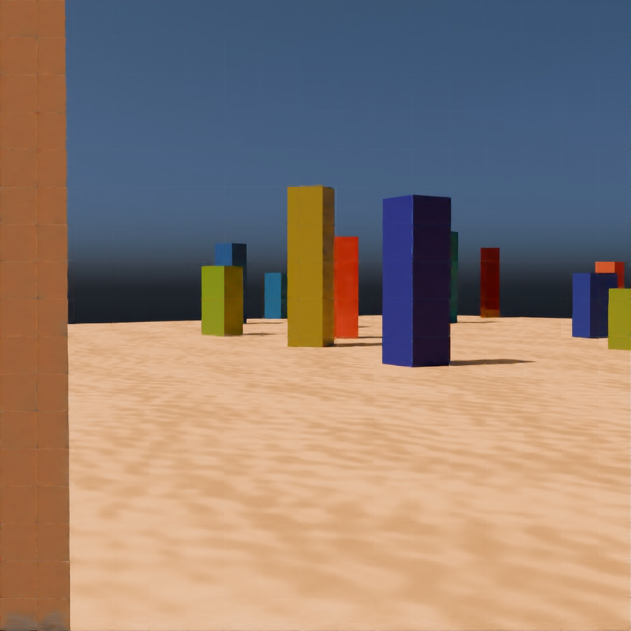
RESULTS AND CONCLUSION
GRID DENOISER

Slide 16

RESULTS AND CONCLUSION
SLIDING WINDOW

Slide 17

RESULTS AND CONCLUSION
SLIDING WINDOW X2

Slide 18
THANK YOU

